Slide 1
Netﬂix Movies and TV Shows Clustering
BY,
Bharath P

Slide 2

Introduction:
Netﬂix is a media distribution company. It started with DVD distribution via mail, but has evolved substantially over the course of its existence. Today, Netﬂix is focused on streaming video. Some of its content is licensed, and some of the content is produced in-house.
Netﬂix originally focused on movies, but today television shows are probably the more common format. Netﬂix works on a subscription model, where users get unlimited access to content with a paid subscription.

Slide 3
Dataset Preview:
This dataset consists of tv shows and movies available on Netﬂix as of 2019. The dataset is collected from Flixable which is a third-party Netﬂix search engine.
Attribute Information
show_id : Unique ID for every Movie / Tv Show
type : Identiﬁer - A Movie or TV Show
title : Title of the Movie / Tv Show
director : Director of the Movie
cast : Actors involved in the movie / show
country : Country where the movie / show was produced
date_added : Date it was added on Netﬂix
release_year : Actual Release Year of the movie / show
rating : TV Rating of the movie / show
duration : Total Duration - in minutes or number of seasons
listed_in : Genre
description: The Summary description

Slide 4
Dataset summary:
The dataset contains 12 columns and 7787 rows.
There also exist some null values in oura data: Percentage of null values in director : 30.68%
Percentage of null values in cast : 9.22% Percentage of null values in country : 6.51% Percentage of null values in date_added : 0.13% Percentage of null values in rating : 0.089%
Since there are very few null values in date_added and rating we will drop them.
Finally we will do some feature engineering to create few new variables:
Compute year_added, month_added and day_added from date_added after converting it into datetime variable.

Slide 5
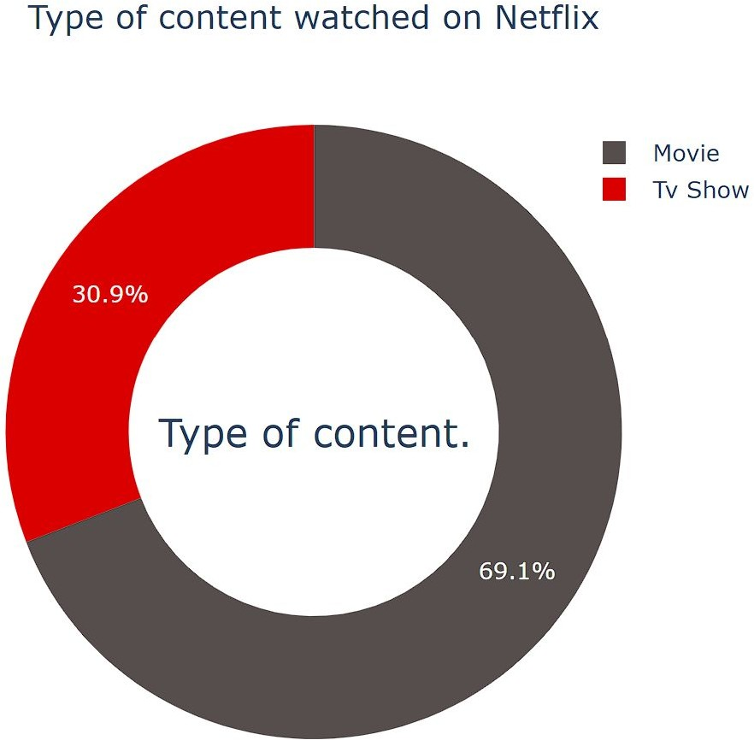
Exploratory Data Analysis:
Type:
69.1% of the content available on Netﬂix are movies; the remaining 30.9% are TV Shows.

Slide 6
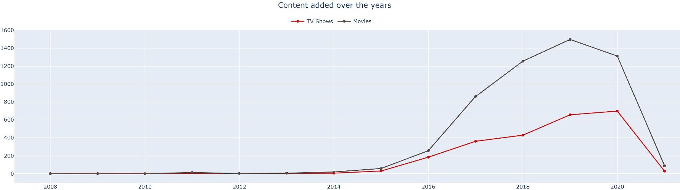
Year_added:
Growth in the number of movies on Netﬂix is much higher than tv shows.
From 2015 we can see a noticeable addition in the number of movies and tv shows uploaded by Netﬂix on its platform.
The highest number of movies and tv shows got added in 2019 and 2020.
The line plot shows very few movies, and tv shows got added in 2021. It is due to very little data collected from the year 2021.

Slide 7
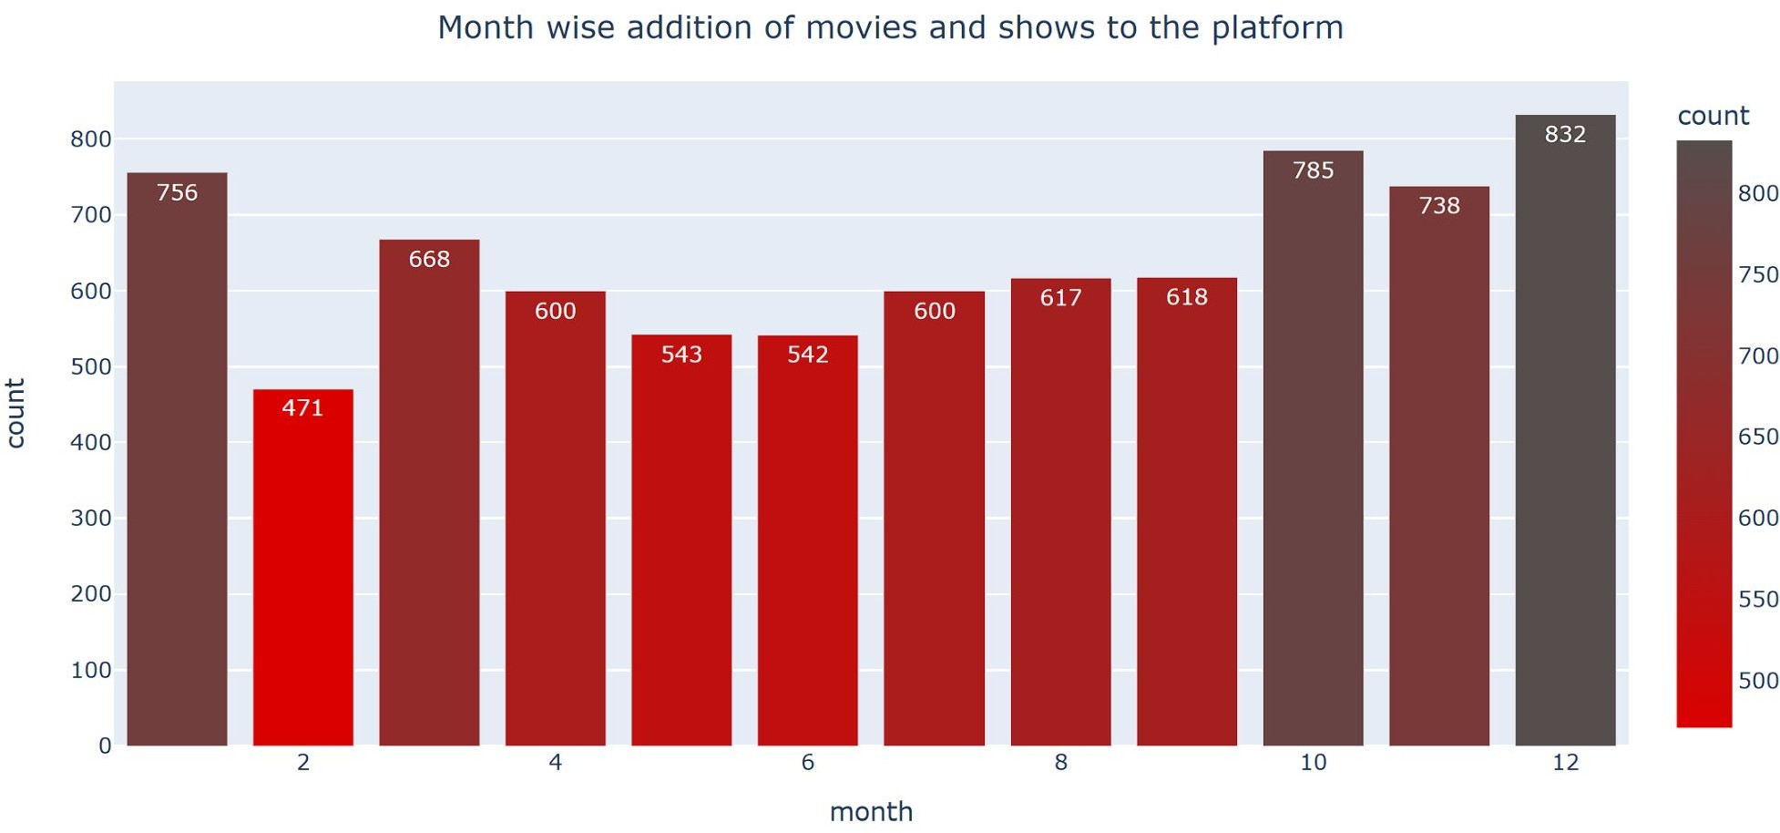
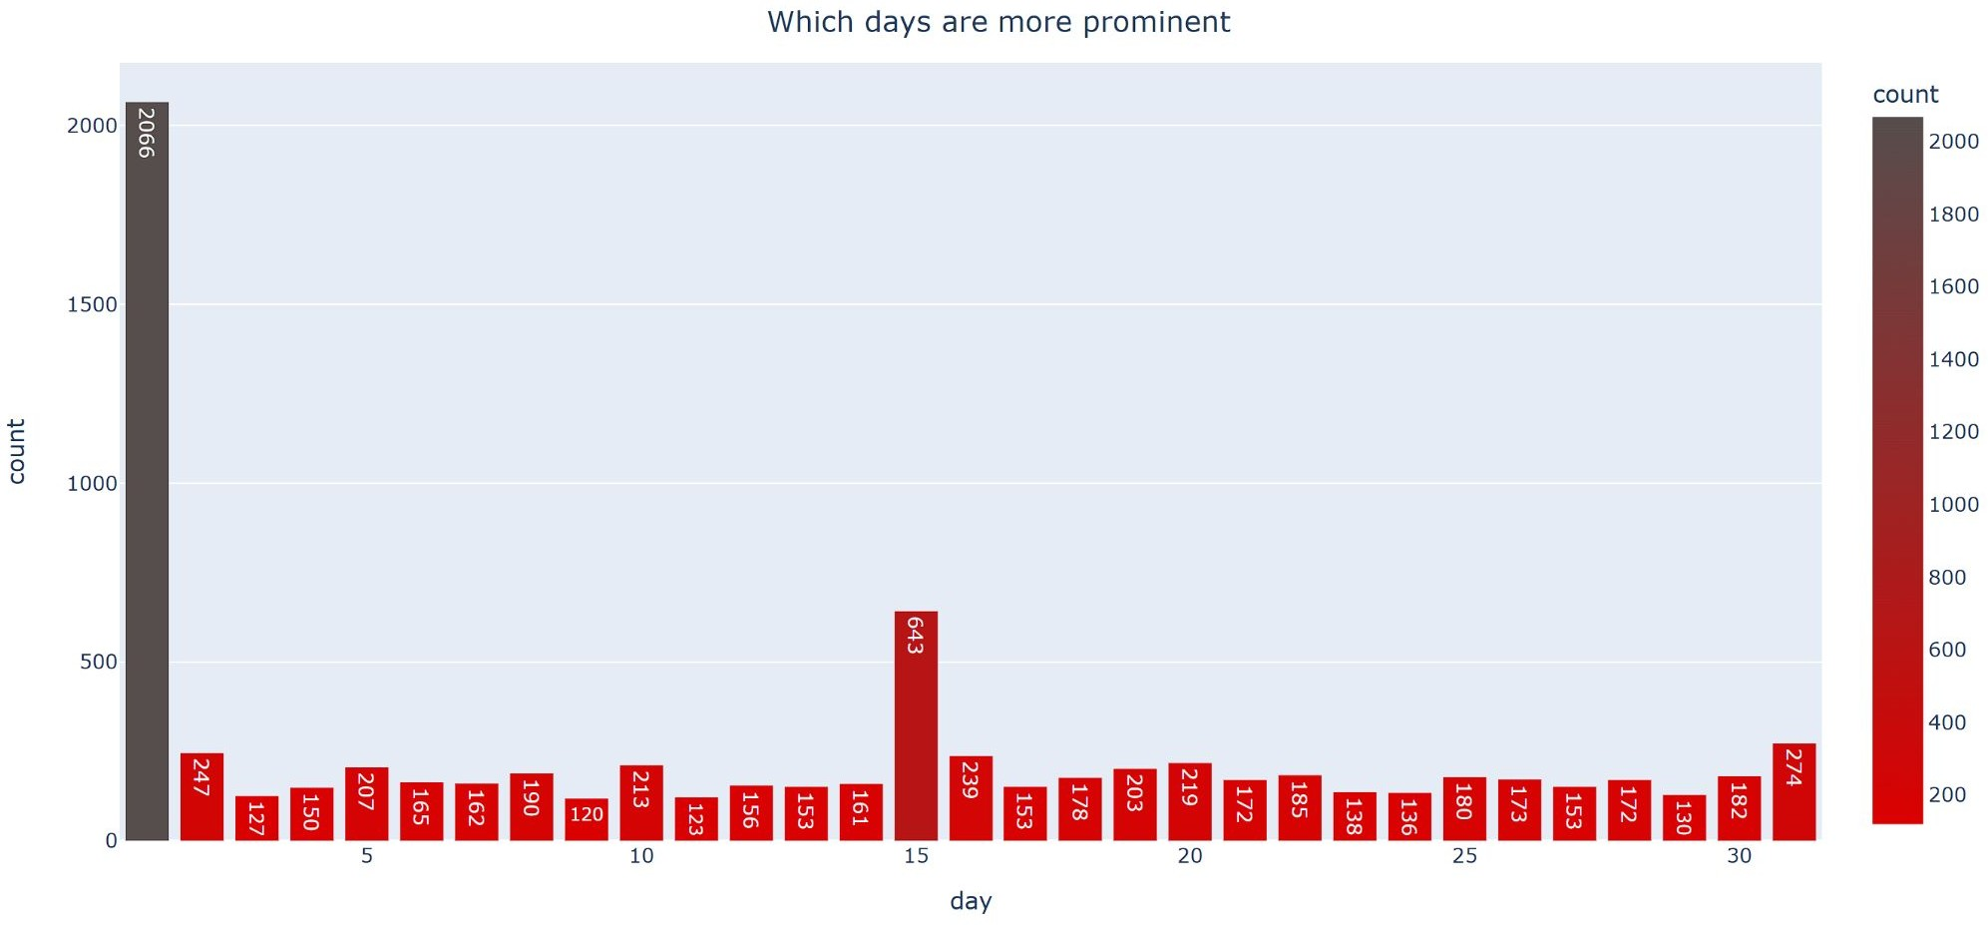
Month_added and Day_added:
Most of the content is uploaded either by year ending or beginning.
October, November, December, and January are months in which many shows and movies get uploaded to the platform.
It might be due to the winter, as in these months people may stay at home and watch shows and movies in their free time.
Most of the content is uploaded at the beginning, middle, or the end of a month.
Which makes 1st, 15th or 31st of a month more prominent in getting new tv shows and movies.

Slide 8
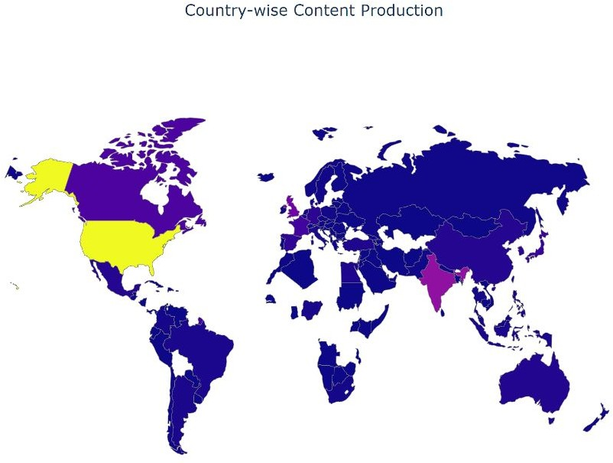
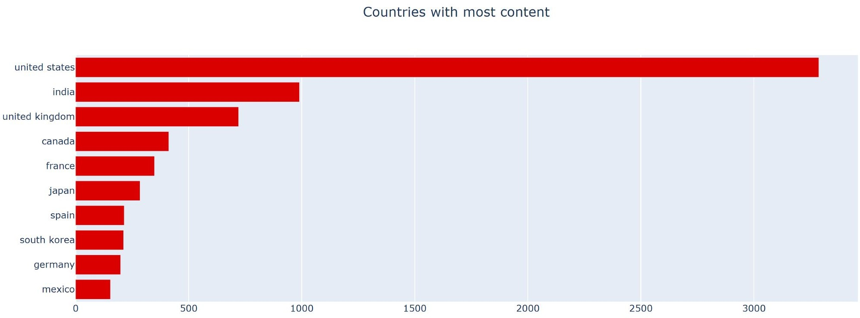

Country:
The majority of the content providers are in the above top-ten countries.
Among which USA, India, and Uk create more than half of the tv shows and movies on the platform.

Slide 9
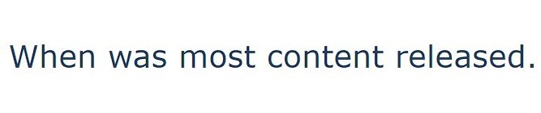
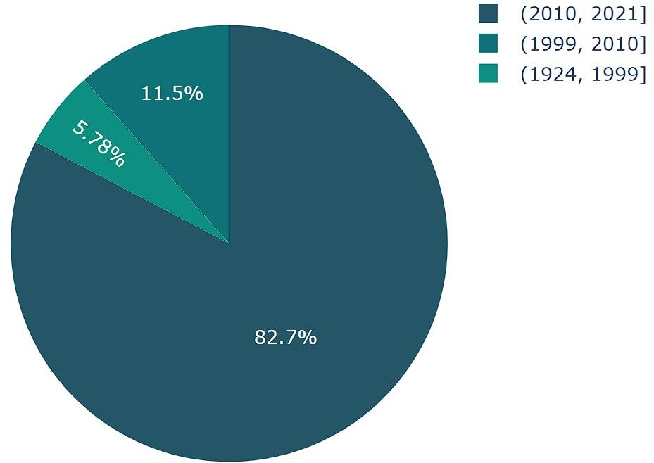
Release_year:
82% of the content available was released between 2010 and 2021.
17.28% of the content available was released before 2010.

Slide 10
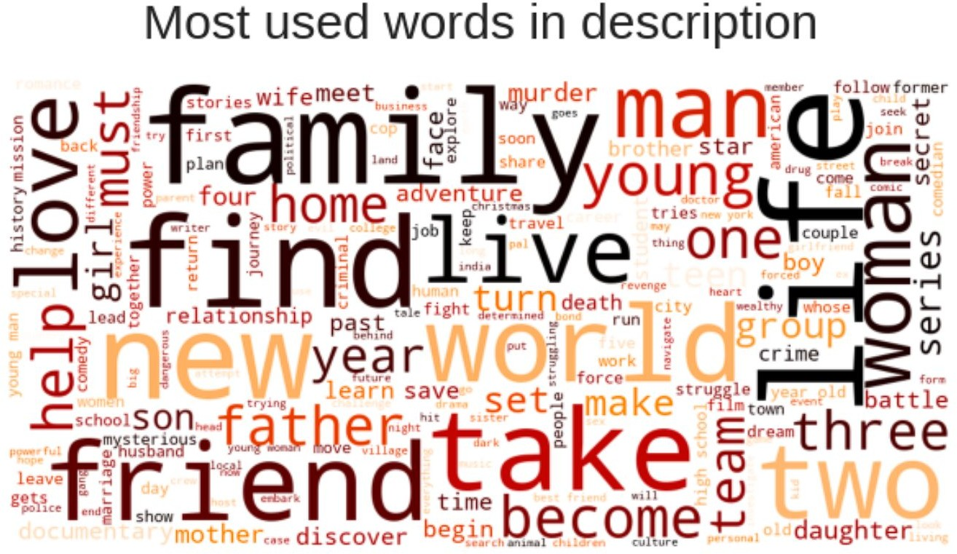
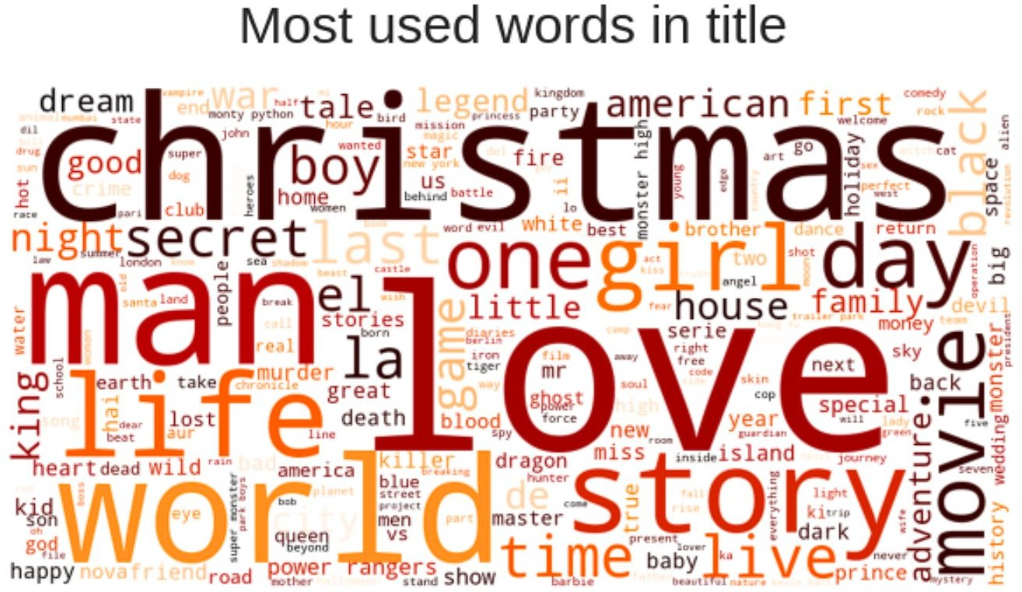
Title and Description:
Most repeated words in title include Christmas, Love, World, Man, and Story.
We saw that most of the movies and tv shows got added during the winters, which tells why Christmas appeared many times in the titles.
Most occurring words in the description of the tv shows and movies are Family, Friend, Love, Life, Woman, Man.

Slide 11
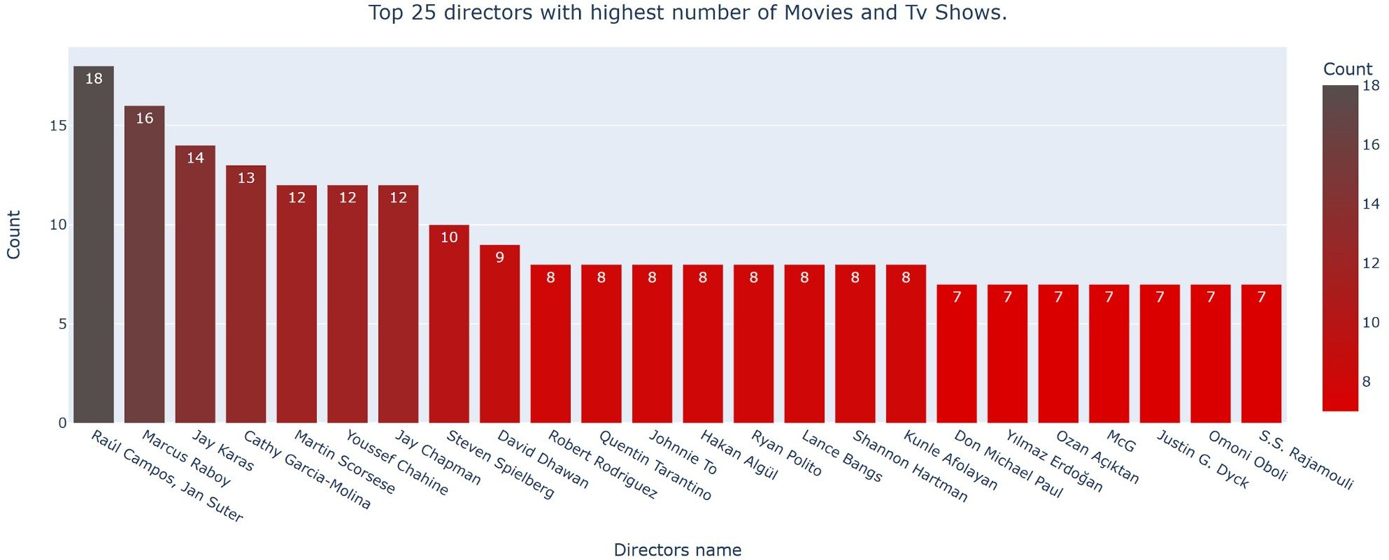
Director:
Raúl Campos, Jan Suter, Marcus Raboy, Jay Karas, Cathy Garcia-Molina, Jay Chapman are the top 5 directors which highest number of movies and tv shows.

Slide 12
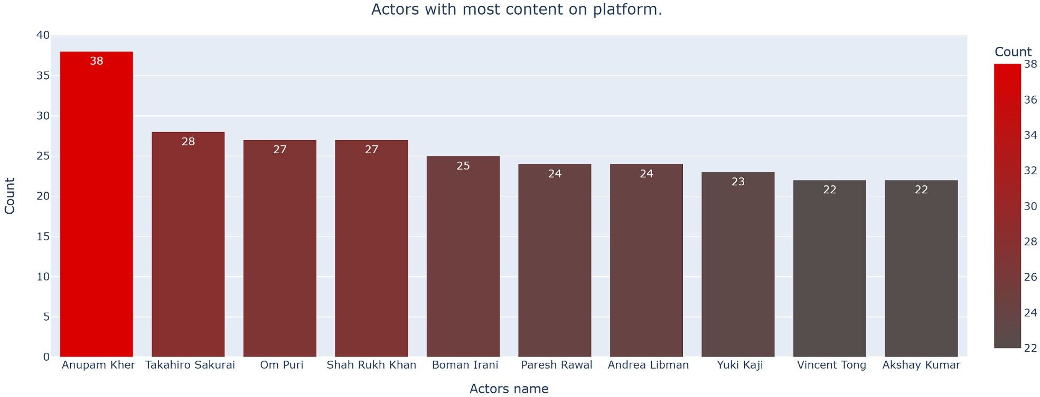
Cast:
Six of the actors in the top ten list with most numbers tv shows and movies are from India.
With Anupam Kher at the top with 38 tv shows and movies in total.

Slide 13
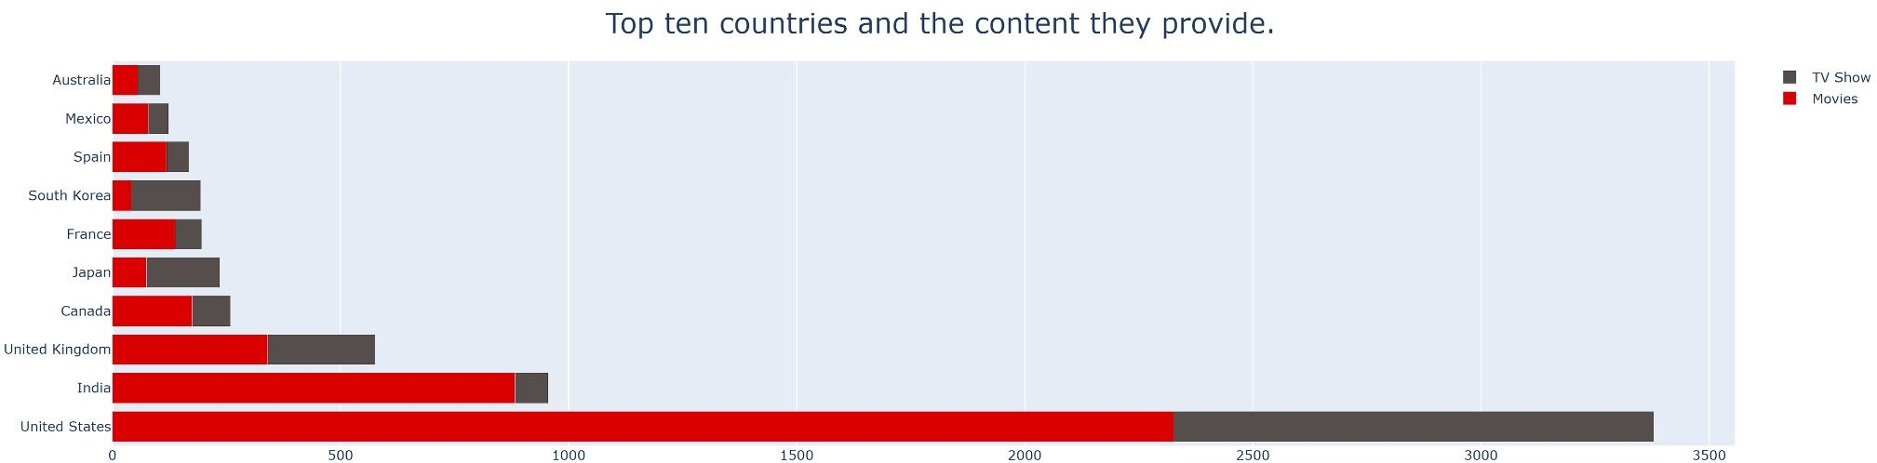
Content vs Country:
The United States is a leading producer of both types of content; this makes sense since Netﬂix is a US company.
The inﬂuence of Bollywood in India explains the type of content available, and perhaps the main focus of this industry is Movies and not TV Shows.
On the other hand, TV Shows are more frequent in South Korea, which explains the KDrama culture nowadays.

Slide 14
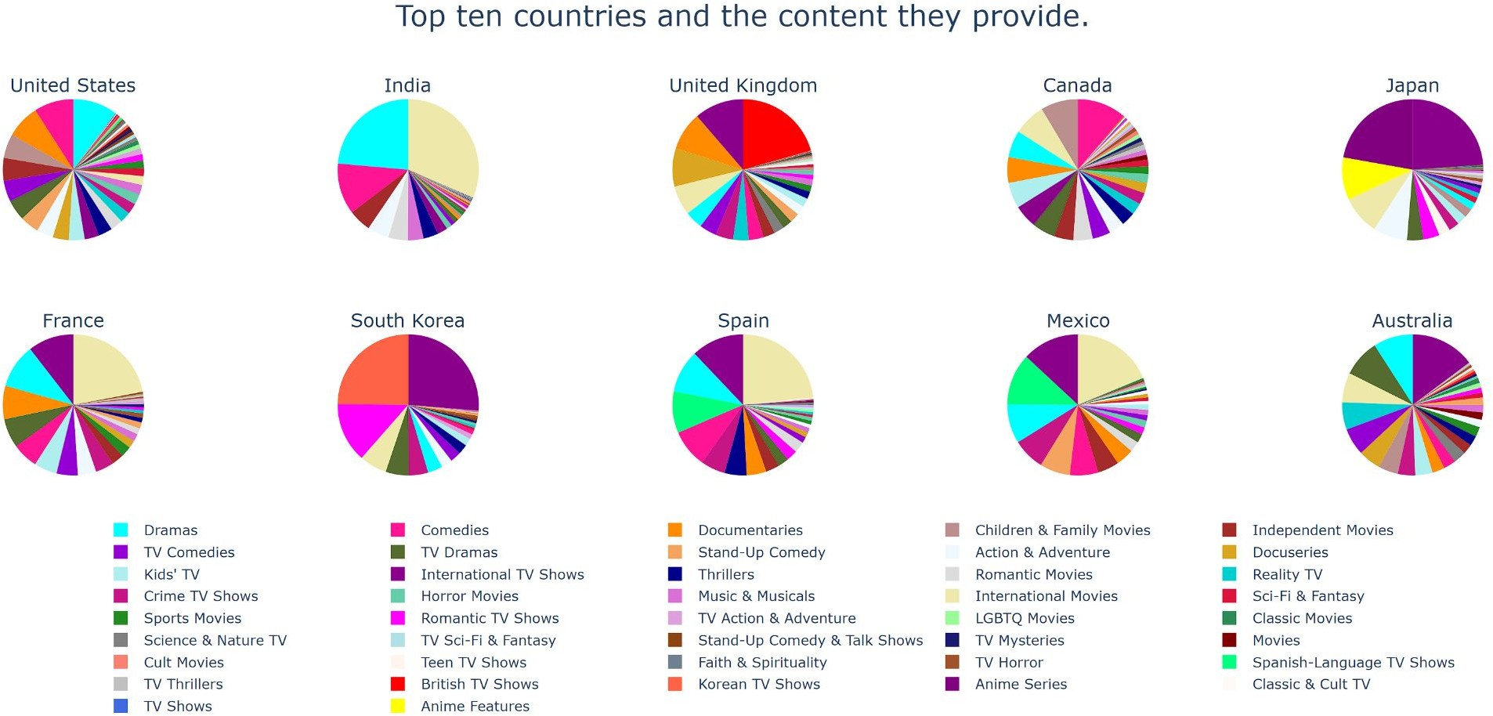
Drama, International Movies, and Comedies seem popular choices in most countries.
British and International Tv Shows dominate in the United Kingdom.
Regional specialties such as Anime in Japan and Korean Tv shows in South Korea are more prominent in these countries; This makes sense as anime has always been popular in Japan, and the rising k-pop culture explains the increase in Korean Tv Shows.
It's also observed that in the countries where the regional language is not English, International Tv Shows and Movies are more in demand.

Slide 15
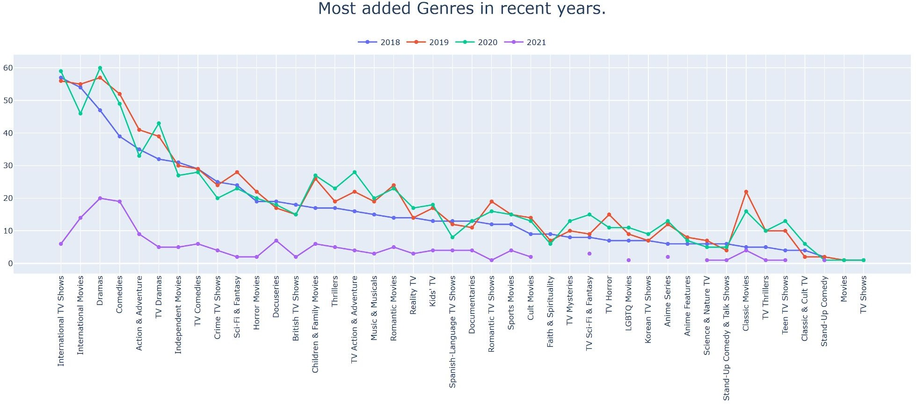
Year_added Vs Type:
From the EDA we did above, we saw that there are more Movies than Tv Shows on Netﬂix, which might be enough to assume that Netﬂix focuses more on Movies than Tv Shows. But the data proves this assumption wrong.
The above line plot shows that Netﬂix has been adding many International Tv Shows in the recent years compared to Movies.
From this observation, we can say that Netﬂix might be shifting slowly towards Tv Shows.

Slide 16
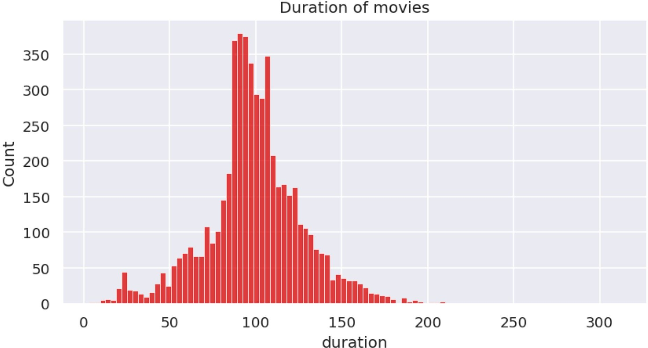
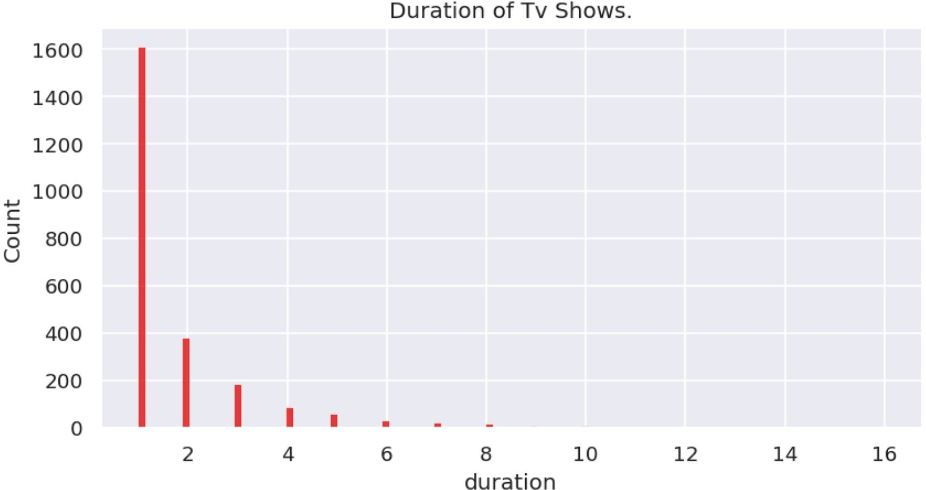
Duration:
Most of the Tv Shows last for 1 or 2 seasons, it is rare for a show to have more than 5 seasons.
Most of the movies last for 90 to 120 minutes.

Slide 17
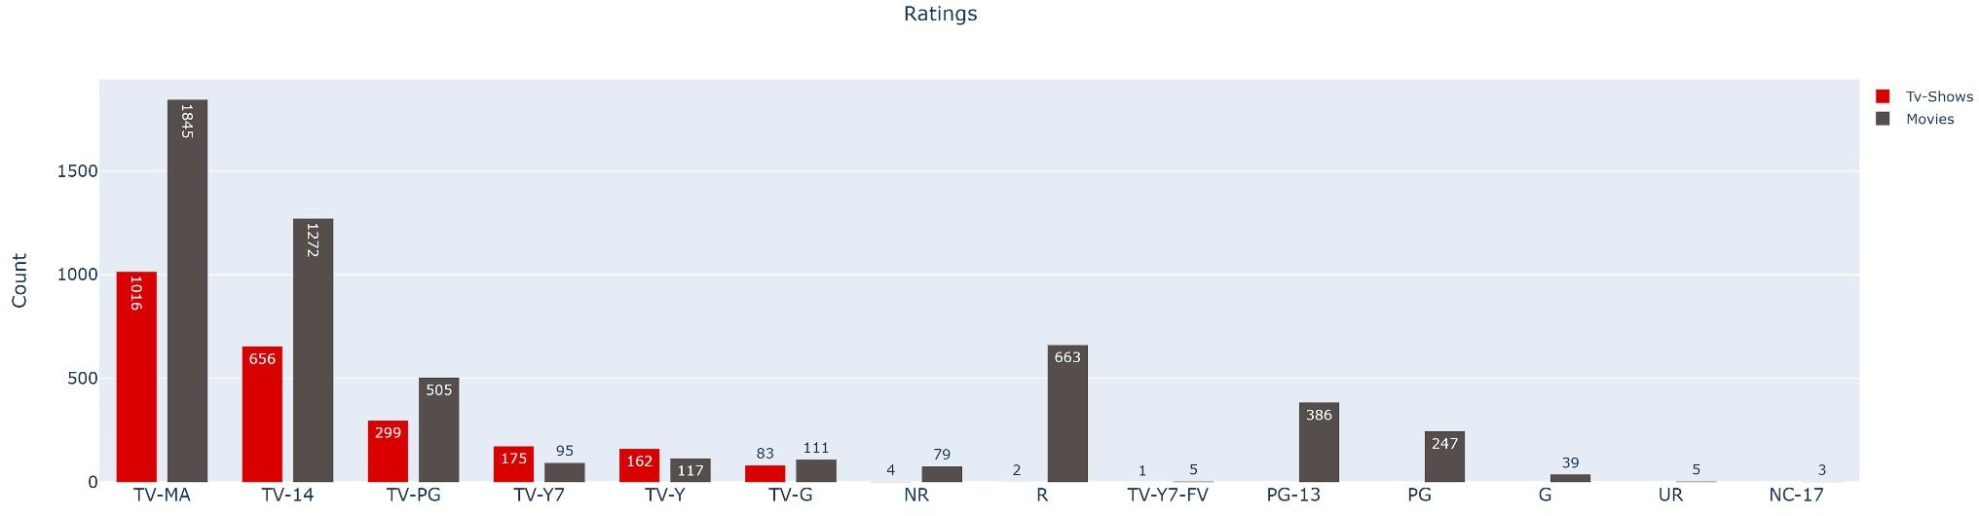
Ratings:
TV-MA tops the charts, indicating that mature content is more popular on Netﬂix.
This popularity is followed by TV-14 and TV-PG, which are Shows focused on Teens and Older kids.
Very few titles with a rating NC-17 exist. It can be understood since this type of content is purely for the audience above 17.

Slide 18
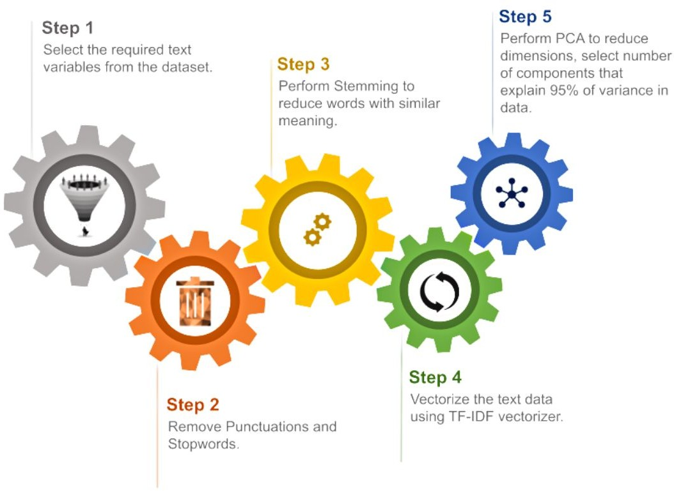
Data Preprocessing.

Slide 19
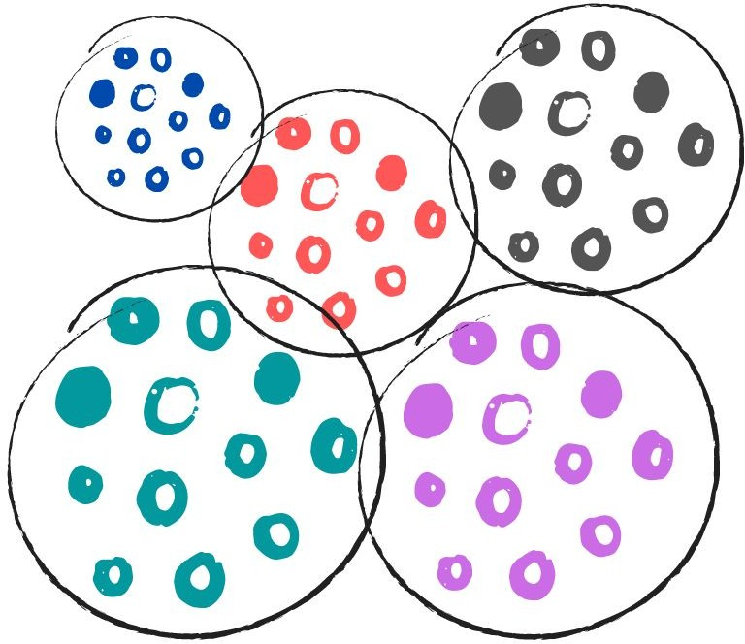
Creating Clusters:
What is clustering?
Clustering is the task of dividing the data points into a number of groups such that data points in the same groups are more similar to other data points in the same group and dissimilar to the data points in other groups. It is basically a collection of objects on the basis of similarity and dissimilarity between them.
How to cluster similar data?
To create clusters we will use the K-Means Clustering; which is an iterative process in which the dataset is grouped into k number of predeﬁned non-overlapping clusters or subgroups, making the inner points of the cluster as similar as possible while trying to keep the clusters at distinct space it allocates the data points to a cluster so that the sum of the squared distance between the clusters centroid and the data point is at a minimum.

Slide 20
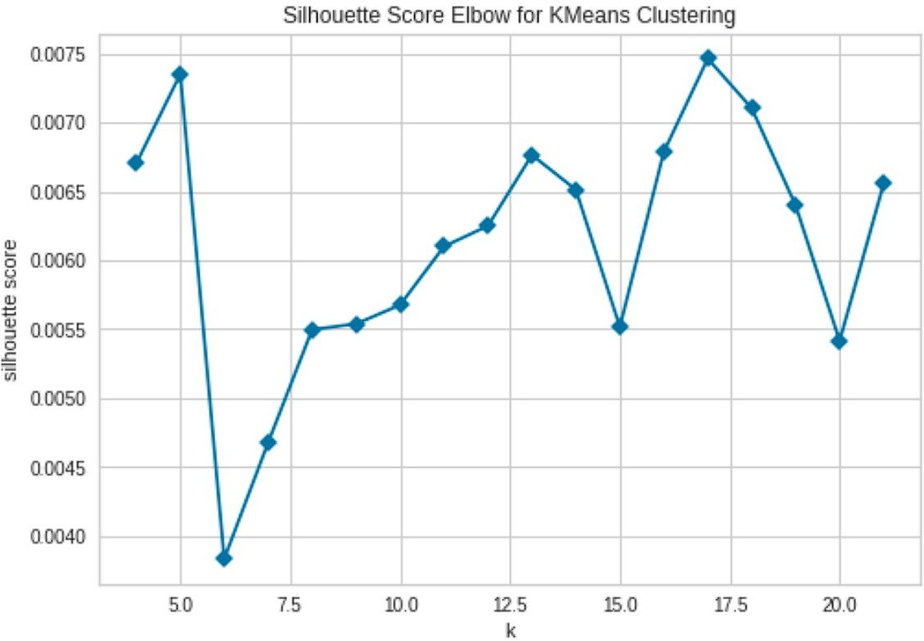
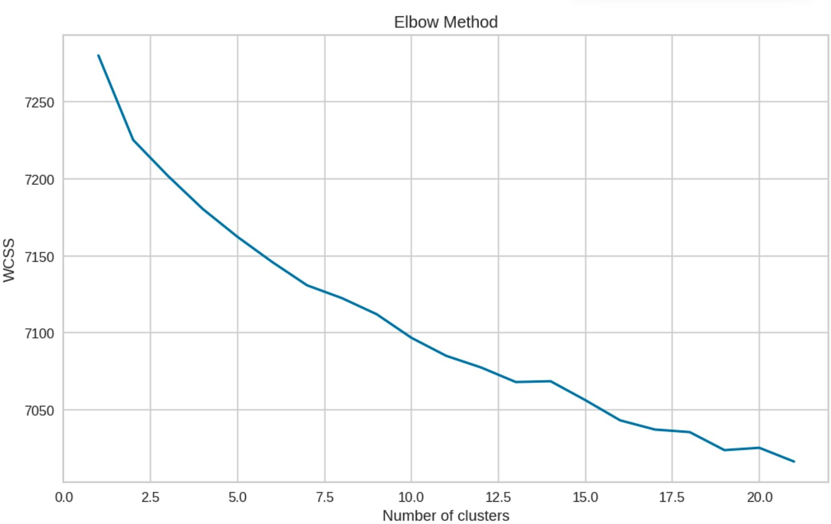
Determining optimal value for k:
Using the Silhouette Score and Elbow Method we select the optimal number of clusters to be 10.

Slide 21
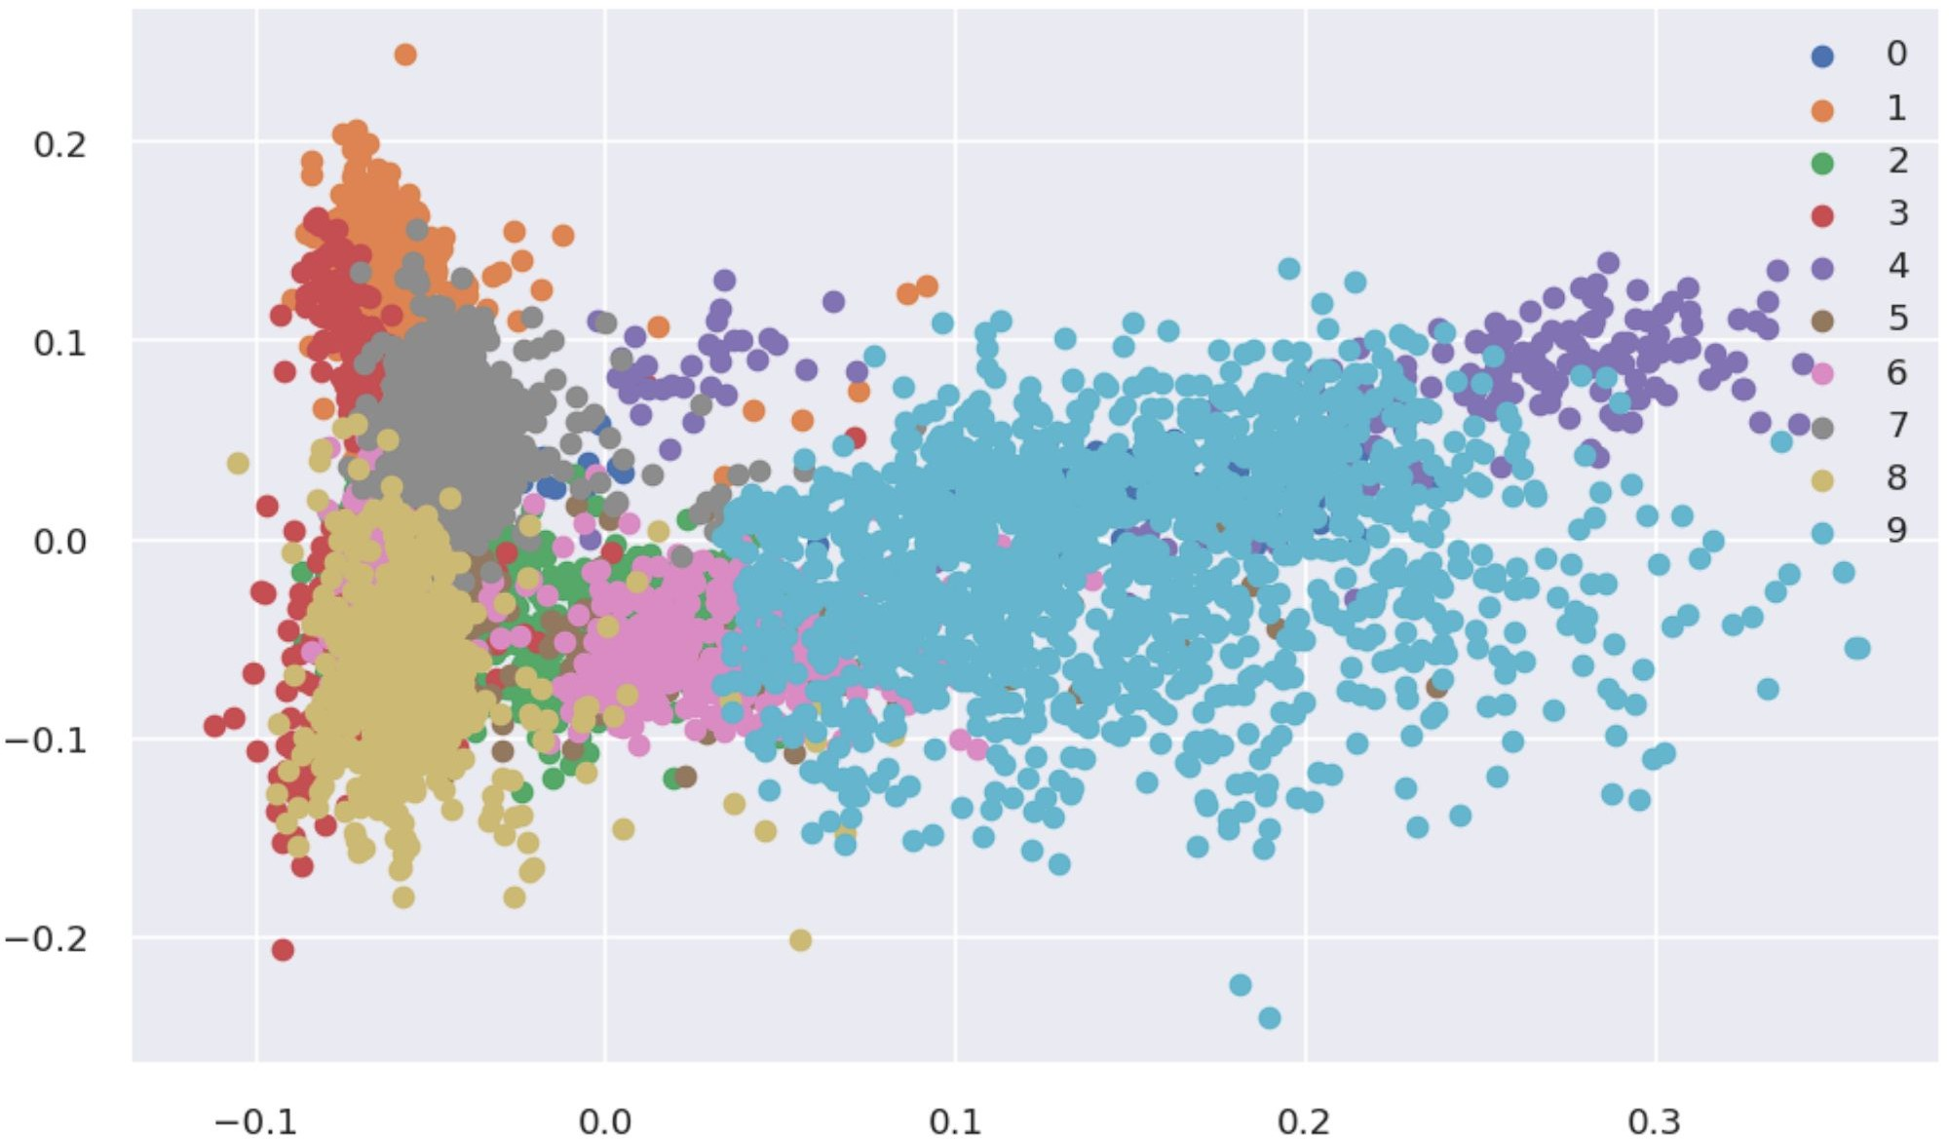
10 Distinct clusters created using kMeans Clustering
The numbers 0 to 9 represent 10-distinct clusters formed by K-means clustering.
Each cluster contains data points similar to those in the same groups but varies from other groups.

Slide 22
Data represented by each cluster:
Cluster 0: Documentaries.
Cluster 1: Family and Children Movies.
Cluster 2: Musical Movies and Documentaries.
Cluster 3: Stand Up Comedy and Comedy Shows.
Cluster 4: Korean and Romantic Tv Shows.
Cluster 5: Science, Nature, Reality, Crime Tv Shows and Docuseries.
Cluster 6: International Movies. Cluster 7: Anime Series and Tv Shows. Cluster 8: International Tv Shows.
Cluster 9: Action, Adventure and Independent Movies.

Slide 23
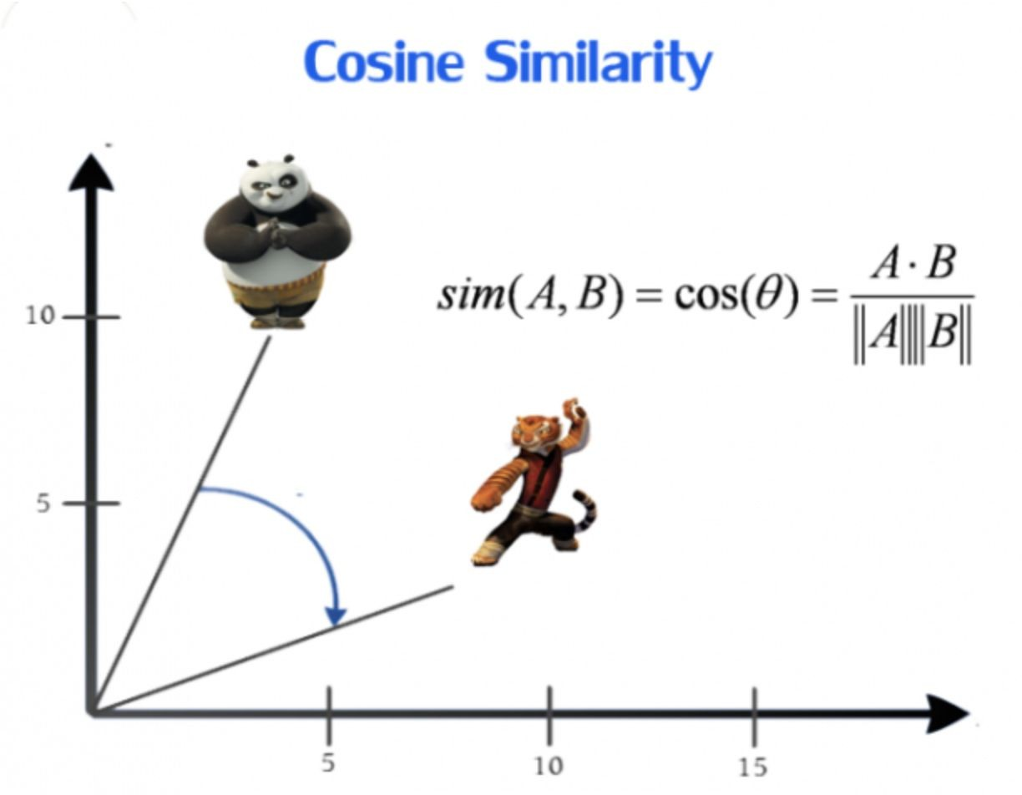
Getting Recommendations:
We obtained recommendations for Movies and Tv- Shows using Cosine similarity.

Slide 24
Conclusions:
It was interesting to ﬁnd that majority of the content available on Netﬂix is Movies.
But in the recent years it has been focusing more on Tv-Shows.
Most of these contents are released either in the year ending or the beginning.
United States and India are among the top 5 countries that produce all of the available content on the platform.
Also 6 of the actors among the top ten actors with maximum content are from India.
TV-MA tops the charts, indicating that mature content is more popular on Netﬂix.
k=10 was found to be an optimal value for clusters using which we grouped our data into 10 distinct clusters.
Using the given data a simple recommender system was created using cosine_similarity and recommendations for Movies and Tv Shows were obtained..

Slide 25

Future Scope:
Integrating this dataset with other external datasets such as IMDB ratings, rotten tomatoes can also provide many interesting ﬁndings.
More time could be given into building a better recommender system, which later can be deployed on web for usage.

Slide 26
Thank you!!

